Slide 1


GRADE 11 STUDENT TEXT BOOK
New curriculum
DILACHIN GENERAL SECONDARY SCHOOL
BIOLOGY

Slide 2

GRADE 11 STUDENT TEXT BOOK
New curriculum
DILACHIN GENERAL SECONDARY SCHOOL
CHEMISTRY

Slide 3

GRADE 11 STUDENT TEXT BOOK
New curriculum
DILACHIN GENERAL SECONDARY SCHOOL
PHYSICS

Slide 4

GRADE 11 STUDENT TEXT BOOK
New curriculum
DILACHIN GENERAL SECONDARY SCHOOL
TECHNICAL DRAWING

Slide 5

GRADE 11 STUDENT TEXT BOOK
New curriculum
DILACHIN GENERAL SECONDARY SCHOOL
GEOGRAPHY

Slide 6
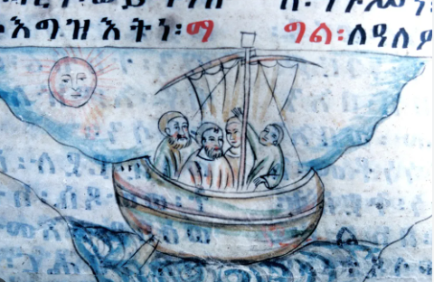
GRADE 11 STUDENT TEXT BOOK
New curriculum
DILACHIN GENERAL SECONDARY SCHOOL
HISTORY

Slide 7

GRADE 11 STUDENT TEXT BOOK
New curriculum
DILACHIN GENERAL SECONDARY SCHOOL
ECONOMICS

Slide 8

GRADE 11 STUDENT TEXT BOOK
New curriculum
DILACHIN GENERAL SECONDARY SCHOOL
GENERAL BUSINESS

Slide 9

GRADE 11 STUDENT TEXT BOOK
New curriculum
DILACHIN GENERAL SECONDARY SCHOOL
ENGLISH

Slide 10

GRADE 11 STUDENT TEXT BOOK
New curriculum
DILACHIN GENERAL SECONDARY SCHOOL
HEALTH AND PHYSICAL EDUCATION

Slide 11
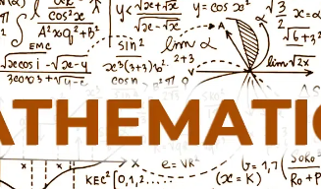
GRADE 11 STUDENT TEXT BOOK
New curriculum
DILACHIN GENERAL SECONDARY SCHOOL
MATHEMATICS

Slide 12

GRADE 11 STUDENT TEXT BOOK
New curriculum
DILACHIN GENERAL SECONDARY SCHOOL
INFORMATION TECHNOLOGY

Slide 13
GRADE 11 STUDENT TEXT BOOK
New curriculum
DILACHIN GENERAL SECONDARY SCHOOL
NATIONAL LANGUAGE

Slide 14
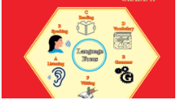
GRADE 11 STUDENT TEXT BOOK
New curriculum
DILACHIN GENERAL SECONDARY SCHOOL
ENGLISH

Slide 15
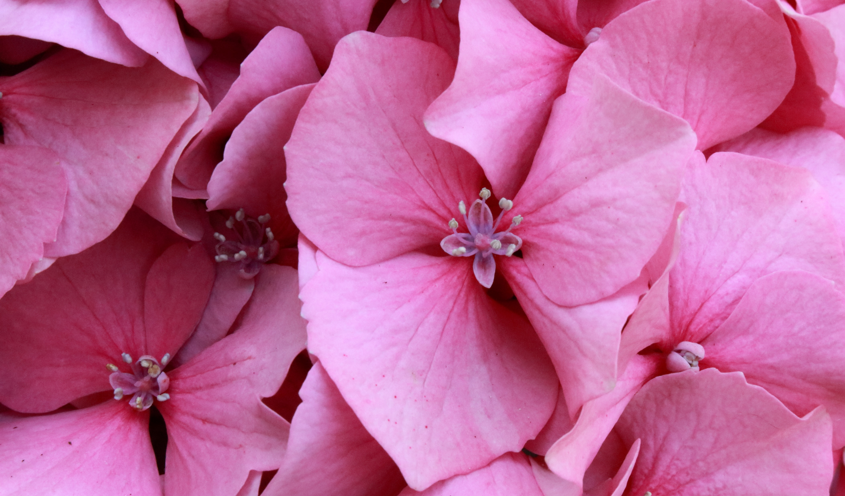
INSPIRATION BOOK
A PIECE OF THE WORLD
THE MOST POPULAR BOOK OF 20XX
ALLAN
MATTSON

Slide 16

INSPIRATION
FROM THE BESTSELLER LIST OF ALL TIME
ALLAN MATTSON
MAKE YOUR DREAM A REALITY

Slide 17

INSPIRATION
MAKE YOUR DREAM A REALITY
ALLAN MATTSON
FROM THE BESTSELLER LIST OF ALL TIME

